Slide 1



Reliance GET Summer Internship Program-2025
Mid- Term Evaluation (4th week)

Slide 2


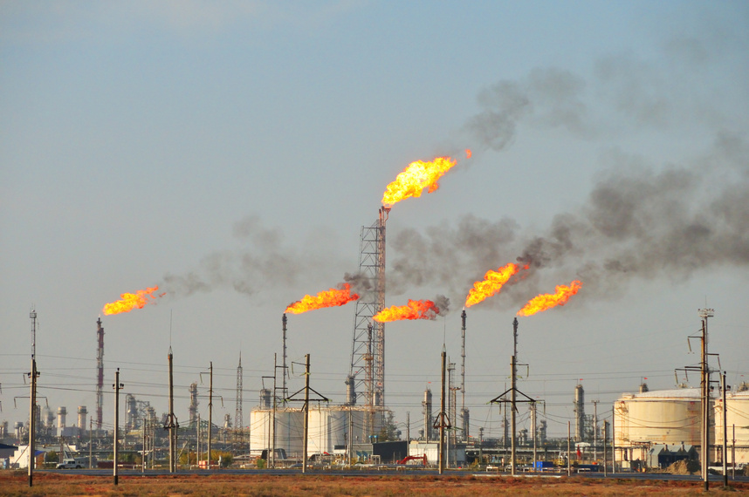
RELIANCE INDUSTRIES LIMITED
JAMNAGAR MANUFACTURING DIVISION
Project Title
Wireless Fire and Gas Detectors Study and Commissioning
Prepared by
Satyaprakash Rath (19604281)
Project Guide & Mentor
Mr.Bhavik Shah
CES Instrumentation

Slide 3



RIL-JMD
Objectives
The primary objectives of this project are:
To study and understand the architecture and functioning of Wireless Fire & Gas Detection Systems, with emphasis on WirelessHART protocol and mesh-based communication.
To analyze the limitations of traditional wired F&G systems and assess the need for wireless alternatives in large-scale industrial environments such as the DTA Complex at RIL Jamnagar.
To gain hands-on experience in commissioning wireless gas detectors, repeaters, field antennas, and gateways in compliance with safety standards (IEC 61508/61511, ATEX/IECEx).
To evaluate and document the performance of deployed devices, including signal strength, data reliability, redundancy, and system response time.
To ensure seamless integration with the SCADA system, enabling real-time monitoring, alarm visualization, and diagnostics over Modbus TCP/IP.
To validate safety logic and system integrity by conducting RF surveys, mesh network formation tests, functional tests, and documentation.

Slide 4

RIL-JMD
Scope of the Project
This project covers the complete lifecycle from system understanding to commissioning and SCADA integration of a Wireless Fire & Gas Detection System at RIL Jamnagar (DTA complex).
The key scope areas include:
1. System Study
Detailed technical study of detectors (smoke, flame, gas, heat) including their working principles and internal components.
Comparison between addressable and non-addressable systems.
2. WirelessHART Network Deployment
Study of WirelessHART protocol, including TDMA, FHSS, AES-128 encryption, and mesh networking.
Commissioning of Vanguard gas detectors, 648DX1 repeaters, 781 Field Link antennas, and 1410S gateway.
3. Commissioning Activities
Pre-commissioning RF site survey, mechanical installation, electrical readiness.
Mesh formation, device tagging, heartbeat configuration, and communication testing.
Functional testing with simulated alarms and validation of network self-healing.
4. SCADA Integration
Data mapping and transfer from gateway to SCADA using Modbus TCP.
Validation of SCADA graphics, alarms, and diagnostics (Wonderware platform).
5. Compliance & Safety
Verification of compliance with SIS standards (IEC 61508, IEC 61511).
Ensuring ATEX/IECEx certifications for all field devices.
6. Training & Handover
Preparation of SOPs and training materials for operations & maintenance teams.
Documentation of network diagrams, test reports, calibration records, and configuration backups.

Slide 5
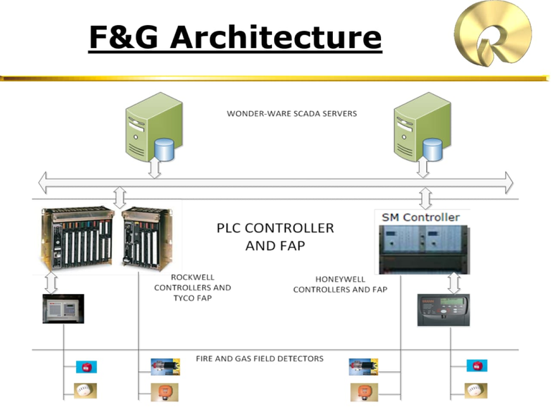
RIL-JMD
1. Introduction
The Fire & Gas Detection System (F&G System) at DTA is a critical safety infrastructure designed to provide early detection and warning for fire incidents and gas leaks. The system ensures operational safety, asset protection, and personnel safety by using a combination of addressable and non-addressable detectors monitored through a SCADA interface.
2. System Suppliers and Architecture
DTA Phase (1998): Tyco (now Johnson Controls)
SEZ and J3 Phases: Honeywell
Front-end Upgrade (2014): Wonderware SCADA by Schneider
Controllers: MINERVA 80, ELTEK
System Type: Mix of addressable (loop-based) and non-addressable (point-to-point) detectors
Protocol: Ethernet with fiber-optic backbone
3. Addressable and Non-Addressable Devices
Addressable Devices:
Connected via MINERVA 80/ELTEK Controllers
Loop-based structure with up to 10 loops per controller
Each loop supports 99 devices
Devices: DSO, DSI, DFI, DMC, DSM
Non-Addressable Devices:
Directly connected to PLC I/O
Devices: DGT, DGC, DGH, DHR, DFX, DGX

Slide 6
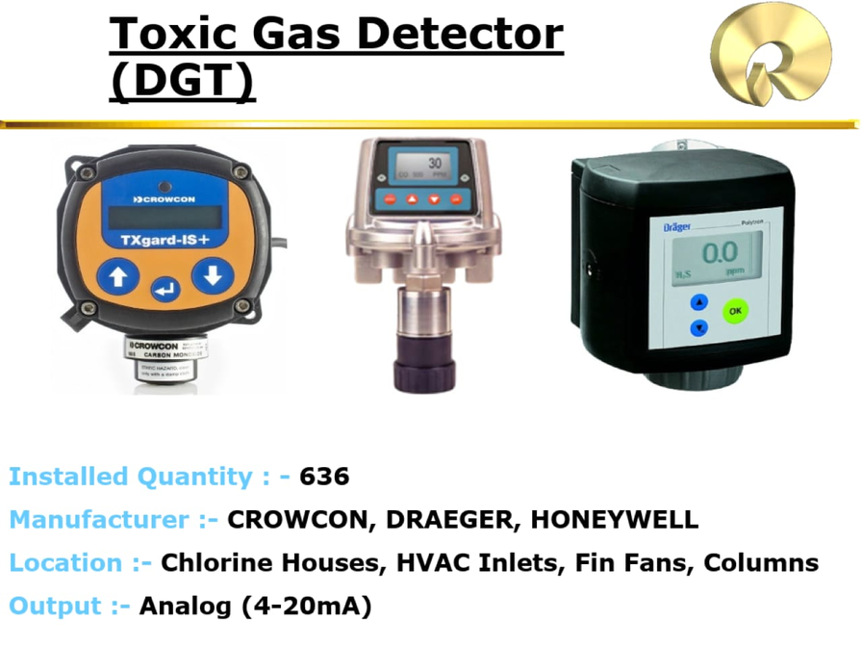
RIL-JMD
4. Detector Inventory Summary
Manual Call Points (DMC) – 2590 units, Thorn/Apollo
Optical Smoke Detectors (DSO) – 2958 units, Thorn/Apollo
Ionization Smoke Detectors (DSI) – 1400 units, Thorn/Apollo
Multisensor Smoke Detectors (DSM) – 421 units, Apollo/Tyco
Rate of Rise Heat Detectors (DHR) – 204 units, Apollo/Thorn
Linear Heat Detectors (DHE) – 239 units, Kidde
IR Flame Detectors (DFI) – 576 units, Thorn/Spectrex
UV/IR Flame Detectors (DFX) – 152 units, Detronics/Spectrex
Toxic Gas Detectors (DGT) – 636 units, Crowcon/Draeger/Honeywell
Combustible Gas Detectors (DGC) – 1615 units, Honeywell
Hydrogen Gas Detectors (DGH) – 271 units, Honeywell
Open Path Gas Detectors (DGX) – 76 units, Zellweger/Spectrex
5. Detectors Working Principle
Manual Call Point (DMC): When the glass is broken or pressed, a micro-switch is triggered that changes the resistance in the loop, initiating an alarm condition. These devices act as manual emergency triggers and are available in both addressable and non-addressable configurations.
Optical Smoke Detector (DSO): This device operates on the light-scattering principle. It includes an IR emitter and a photodetector. In clean air, the beam does not reach the detector due to strategic placement of baffles. When smoke enters the chamber, it scatters the light beam, allowing it to hit the photodetector and trigger an alarm proportional to the smoke density.
Ionization Smoke Detector (DSI): Uses a small radioactive source (Americium-241) to ionize air between two electrodes. In the presence of smoke, the ions attach to particles, reducing the current flow. This change in ion current is detected electronically and used to raise an alarm. It is highly sensitive to smaller smoke particles produced by flaming fires.
Multisensor Smoke Detector (DSM): Combines data from an optical smoke sensor and a heat sensor. A microcontroller processes both inputs to distinguish between real fires and deceptive phenomena. It enhances immunity against false alarms while remaining sensitive to rapid temperature rises or visible smoke.
Rate of Rise Heat Detector (DHR): This detector contains two thermistors: one exposed to the environment and one sealed. A rapid increase in ambient temperature causes a voltage difference between the thermistors, triggering an alarm. It is suitable for areas where smoke detectors may be ineffective, such as kitchens or dusty environments.
Linear Heat Detector (DHE): Utilizes a heat-sensitive cable that changes its resistance characteristics when heated. The cable consists of polymer insulation with embedded conductive materials, and its resistance is continuously monitored by an interface unit. Sudden temperature increases are recognized as alarm conditions.
IR Flame Detector (DFI): Detects hydrocarbon flames based on their CO₂ emission spectrum using a triple-IR (3IR) sensor. It analyzes radiation in the 4.2–4.6 µm (CO₂ emission), 4.0–4.2 µm (eliminates hot body radiation), and 4.8–5.2 µm (background flicker) bands. Only when a flickering IR source fits the fire signature, an alarm is raised.

Slide 7
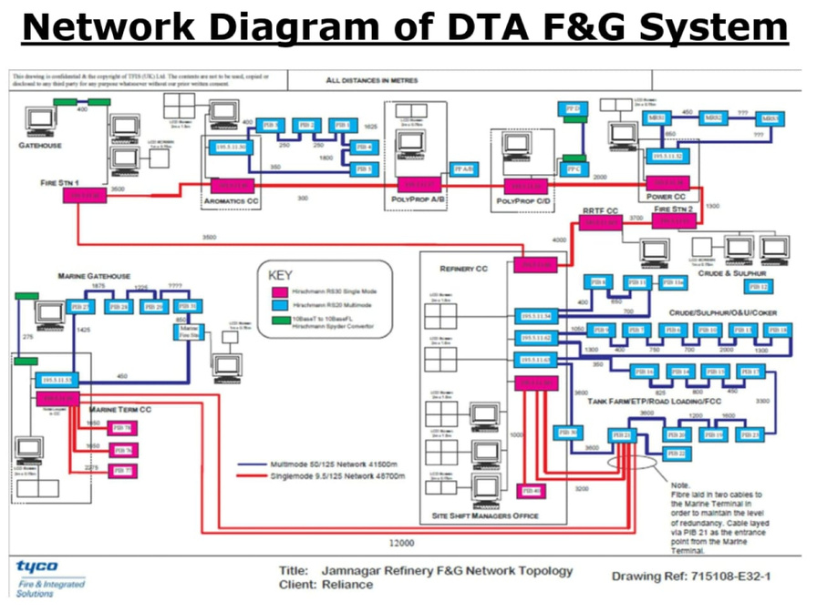
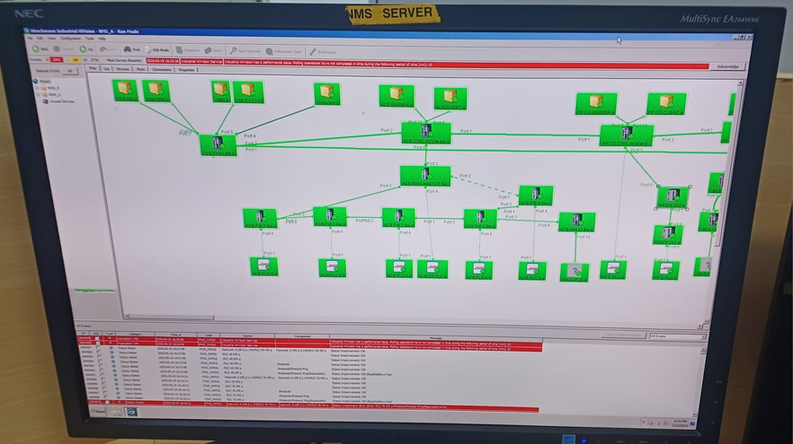
RIL-JMD
UV/IR Flame Detector (DFX): Combines ultraviolet and infrared sensors to detect flame presence. The UV sensor detects radiation in the 180–300 nm range, while the IR sensor detects radiation in the 4.4–4.6 µm range. A logic circuit compares the two to improve immunity against false alarms and ensure a reliable flame detection.
Toxic Gas Detector (DGT): Uses electrochemical sensors, where the gas diffuses through a membrane into a cell containing electrolyte and electrodes. A redox reaction occurs on the electrodes, generating a current that is linearly proportional to the gas concentration. It is suitable for gases such as H₂S, CO, Cl₂, and NH₃.
Combustible Gas Detector (DGC): Based on non-dispersive infrared (NDIR) technology, it measures gas concentration through differential absorption. Two IR beams are passed through the sample gas—one at the absorption peak of the target gas and the other at a non-absorbing reference wavelength. The attenuation difference determines gas presence.
Hydrogen Gas Detector (DGH): Uses a catalytic pellistor sensor consisting of a platinum coil embedded in a ceramic bead coated with a catalyst. When hydrogen is present, it combusts on the catalyst surface, heating the coil and increasing its resistance. This resistance change is processed to determine hydrogen concentration.
Open Path Gas Detector (DGX): Projects a beam of infrared light between a transmitter and a receiver across a monitored open area. When gas is present, it absorbs specific IR wavelengths, reducing signal strength. The system calculates the integrated gas concentration (expressed in LEL·m) over the path length.
6. SCADA Monitoring System
Wonderware SCADA is used to monitor the entire F&G network. Addressable devices send their status to the PLC via MINERVA 80 and MIPLOC interface. Non-addressable devices are directly connected to the PLC I/O. The PLC communicates to the SCADA system via Ethernet, with optical fiber transmission for wider coverage.
SCADA offers three levels of graphical monitoring:
Level 1: Area overview
Level 2: PIB/Substation-specific view
Level 3: Individual detector status
Color codes are used for status visualization:
Green – Healthy
Yellow – Fault
Red – Fire
Blue – Toxic Gas
Orange – Combustible Gas
7. Alarms and Output Devices
Visual Devices:
3-Way Beacon – 1127 units, MEDC
FM-200 Status Lamp – 27 units, MEDC
Audible Devices:
Alarm Bells – 15 units, Fulleon
FM-200 Sounders – 27 units, Signature
Manual/Control Devices:
FM-200 Selector Switch – 27 units, BALIGA
FM-200 Manual Push Button – 54 units, BALIGA
Color Indication:
Red – Fire
Amber – Combustible Gas
Blue – Toxic Gas
Logical Trip Functions:
FM-200 discharge upon 2ooN smoke detector alarm
HVAC trip on DGT/DGC alarm or smoke detection
Deluge Skid activation upon confirmed fire detection

Slide 8

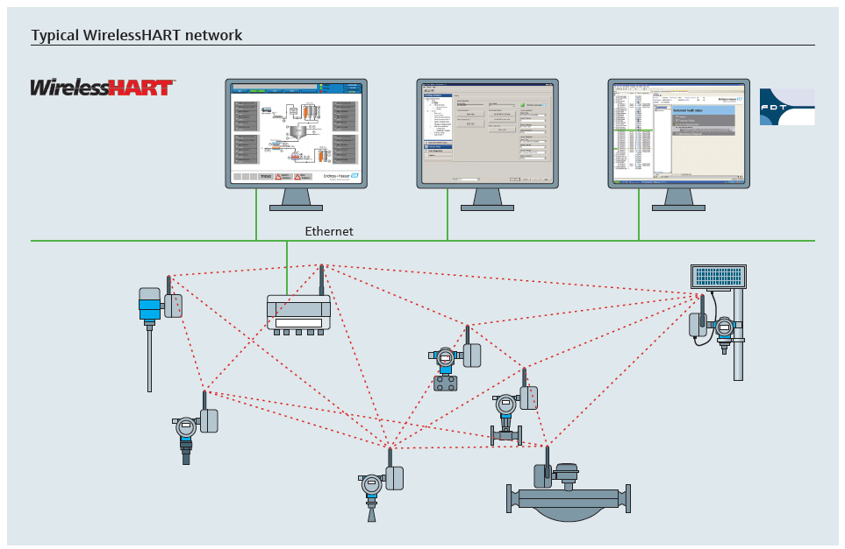
RIL-JMD
🔄 Why Shift from Wired to Wireless Fire & Gas Detection Systems ?
✅ 1. Cost & Time Efficiency
Wired systems require extensive cabling, conduits, and civil work.
Wireless systems eliminate these, cutting:
CAPEX by up to 50%
Commissioning time by 40–60%
✅ 2. Easy Deployment in Hazardous Zones
Wireless detectors (e.g., Vanguard CH₄/H₂S) are ideal for remote or high-risk areas (e.g., flare zones) where cabling is impractical.
Battery-powered devices support 3–5 years of operation(depends on scan time).
✅ 3. Scalable & Flexible
Wired: Fixed, rigid structure; rework needed for expansion.
Wireless: Plug-and-play; devices auto-join the mesh network with no wiring changes.
✅ 4. Reliable Communication
WirelessHART uses:
TDMA for synchronized data transfer
FHSS for interference resistance
Mesh topology for self-healing paths
✅ 5. Smarter Diagnostics
Wired 4–20 mA: One signal only.
WirelessHART: Gas level + battery status + signal quality + alarms — all remotely accessible.
✅ 6. Standards & Safety
Certified to:
IEC 62591 (WirelessHART)
IEC 61508/61511 (SIL 2/3)
ATEX/IECEx Zone 1/2

Slide 9
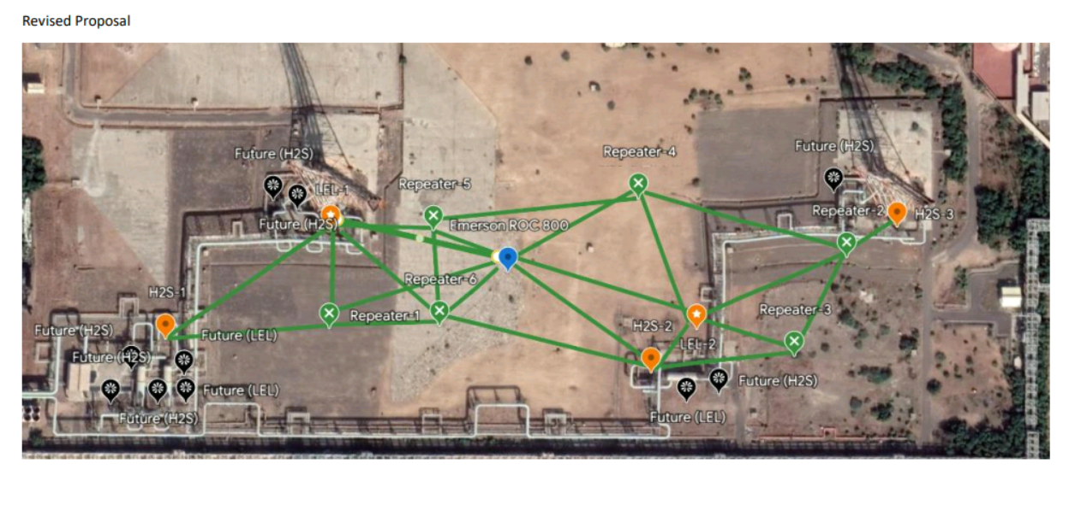
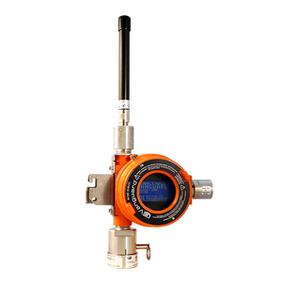
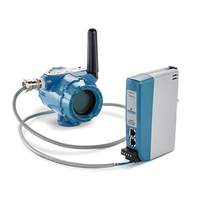
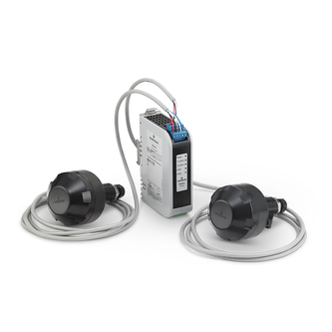
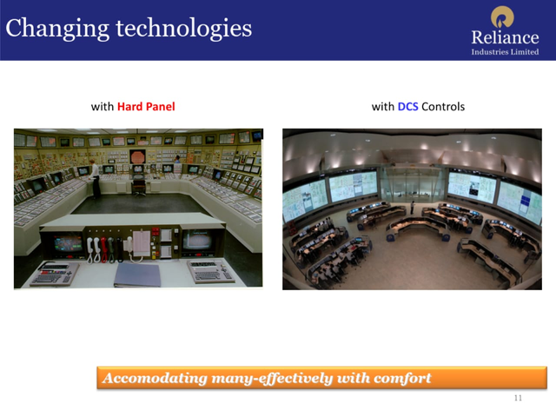
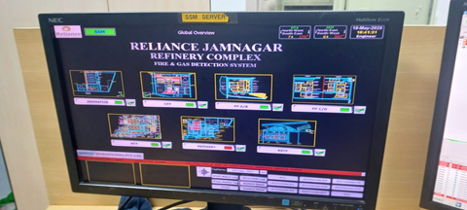
RIL-JMD
Proposed Wireless System Architecture & Components
FIELD LAYER
Vanguard CH4/H2S Detectors
REPEATER LAYER
648DX1 Repeater - Signal Extension
Structure:
Field Devices: Comprise sensors (electrochemical for H2S, catalytic bead for CH4), a microprocessor, WirelessHART modem, battery pack, and diagnostic circuitry.
Repeaters: Contain a WirelessHART transceiver, RF signal amplifier, routing engine, memory for dynamic routing tables, and intrinsically safe battery pack.
Field Link Antenna: Houses industrial RF receivers/transmitters, surge protection, signal processing units, and weatherproof housing.
Function:
Devices communicate wirelessly by relaying data packets in a multi-hop manner.
Each device receives and forwards data to the next device (“hop”) closer to the gateway.
Repeaters extend communication range and enable mesh network self-healing by providing alternate paths.
The Field Link Antenna acts as the primary receiver, forwarding data to the gateway for integration with control systems.
Communication
Infrastructure
781S - Field Link Antenna
GATEWAY & Control Layer
1410S Gateway ⟶ DCS/PLC
Supervisory & Interface Layer
SCADA/HMI Systems

Slide 10

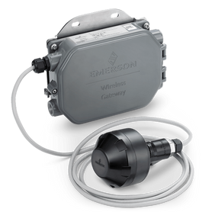
RIL-JMD
🔁 Why the System Follows This Order: Detector → Repeater → Antenna → Gateway → SCADA/HMI
🔹 1. Detector – Smart Sensing & First Communication Layer
What it does:
Detects physical hazards: gas leaks (CH₄, H₂S), flame, smoke, heat.
Converts physical parameters into digital data.
Sends data via inbuilt Wireless HART modem, including:
Gas levels
Battery status
Device diagnostics
Signal strength
Encrypts all data using AES-128 before transmission.
Why first?
It’s the source of hazard intelligence. Without a detector, no signal or alarm can originate.
🔹 2. Repeater – Mesh Strengthener & Range Extender
What it does:
Receives Wireless HART packets from detectors or other repeaters.
Boosts and forwards data to the next node (antenna or another repeater).
Maintains dynamic routing tables for mesh path selection.
Ensures multi-hop reliability.
Why next?
Detectors alone may not reach the antenna directly due to obstacles. Repeaters create self-healing, redundant paths for resilient communication.
🔹 3. Field Link Antenna – Aggregation & Signal Conditioning Node
What it does:
Centralized receiver of WirelessHART traffic from all mesh nodes.
Buffers, filters, and organizes incoming packets.
Designed for elevated mounting, ensuring optimal RF reception.
Why after repeater?
Receives multi-hop traffic from multiple nodes and passes clean, consolidated signals to the gateway.
🔹 4. Gateway – Protocol Manager & Field-to-Control Translator
What it does:
Manages the WirelessHART network: TDMA slot scheduling, device joining, security checks.
Converts WirelessHART data into Modbus TCP/IP or OPC UA.
Sends processed data to PLC/DCS and SCADA.
Why here?
It’s the bridge between field wireless network and industrial control systems. It also performs diagnostics, logging, and protocol translation.

Slide 11
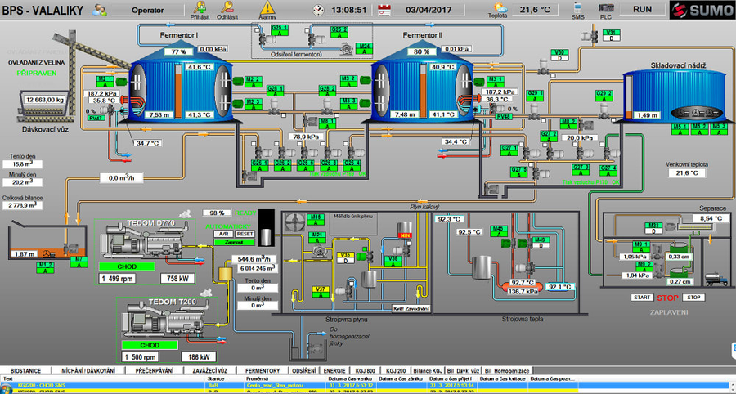
RIL-JMD
🔹 5. SCADA/HMI – Visualization, Monitoring & Operator Decision Interface
What it does:
Shows alarms, gas concentrations, battery life, and device health on real-time dashboards.
Uses tiered graphical views:
Level 1 – Plant Overview
Level 2 – PIB/Substation
Level 3 – Device-specific status
Records trends, events, and supports remote diagnostics.
Why last?
Operators need processed, actionable data. SCADA is the final stage where data becomes visible, useful, and decision-driven.
📡 WirelessHART-Specific Benefits Embedded in the Architecture
Feature | Benefit
TDMA (Time Division Multiple Access) | Eliminates packet collision, ensures time-synchronized, deterministic data delivery.
FHSS (Frequency Hopping Spread Spectrum) | Operates on 15 channels (2.4 GHz ISM band); resists interference and EMI.
Self-Healing Mesh Network | Ensures alternate routing; no single point of failure.
AES-128 Encryption | Secure communication across hazardous industrial environments.
Multivariable Transmission | Sends gas level, diagnostics, signal strength — unlike 4–20 mA which sends only one.
Battery-Powered | Operates independently for 3–5 years in hazardous zones; supports deployment flexibility.
IEC 62591 Compliant | Standardized interoperability and safety assurance.

Slide 12
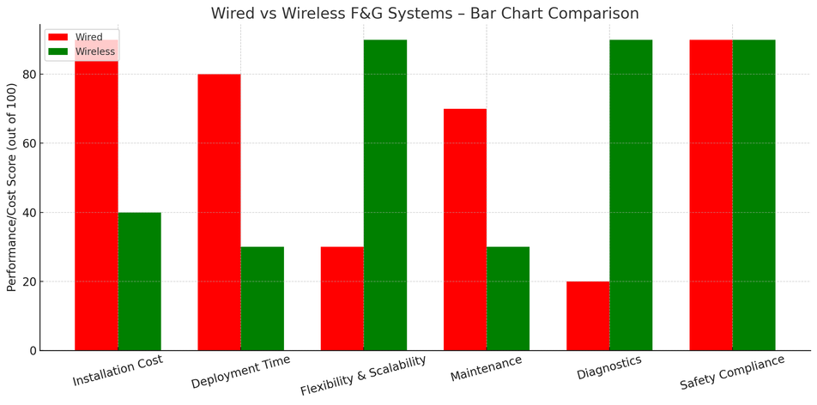
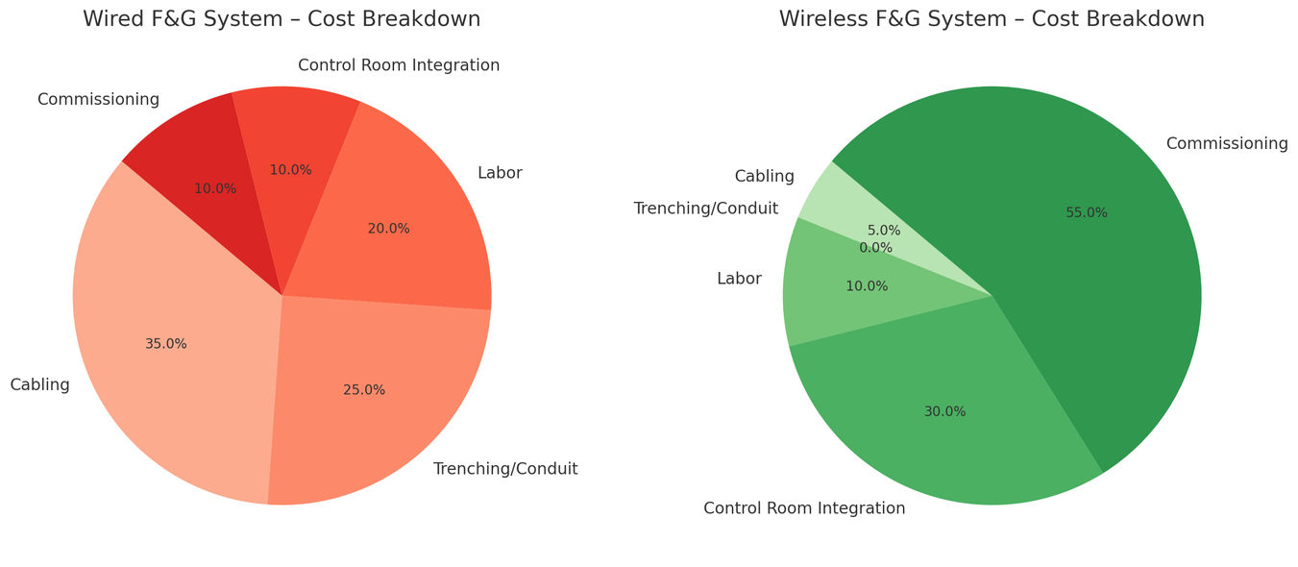
RIL-JMD
📊 OSI Model Mapping of the Wireless F&G Architecture
OSI Layer | Component | Function
Physical (Layer 1) | Detectors, Repeaters, Antennas | RF transmission over 2.4 GHz band
Data Link (Layer 2) | Wireless HART Protocol | TDMA scheduling, link establishment
Network (Layer 3) | Mesh Network Routing (Repeaters) | Path discovery, self-healing hops
Transport (Layer 4) | WirelessHART Gateway | Ensures end-to-end delivery, packet reassembly
Session (Layer 5) | Gateway ↔ SCADA link | Communication sessions, Modbus/OPC handshake
Presentation (Layer 6) | Protocol Converters, SCADA Interface | Converts WirelessHART to Modbus/OPC format
Application (Layer 7) | SCADA/HMI | Visualization, logging, user decision support
✅ Summary: Why This Order is Followed
Step | Component | Why in Sequence
1 | Detector | Detects hazards and initiates data flow
2 | Repeater | Extends communication range and builds resilient mesh
3 | Antenna | Aggregates signals and ensures robust reception
4 | Gateway | Manages the network and bridges field to control layer
5 | SCADA/HMI | Final display and decision interface for operators

Slide 13



Work Progess & Learnings -
RIL-JMD
Completed So Far
System Architecture: Finalized Wireless HART-based design with detectors, repeaters, antenna, gateway, SCADA interface.
Device Delivery & Verification: All field devices received, checked for model, certification, battery status.
Wireless Upgrade Benefits:
~50% CAPEX savings (no cabling/trenching).
Fast deployment in Zone 1 areas.
Remote diagnostics, scalability, self-healing mesh.
Plot Plan & Layout:
Revised plot approved; placement planned based on leak potential, zone classification, and RF line-of-sight.
Ongoing Activities
Finalizing detector and repeater locations near compressors, PRVs, flare knockouts, etc.
Ensuring elevation and alignment for RF visibility.
Next Steps:
Mechanical Installation: Mounting detectors/repeaters with Zone 1 brackets.
RF Site Survey: Validate mesh hops, signal strength, and link quality.
Commissioning Phases:
Power-up and mesh formation.
Gateway setup and SCADA integration.
Functional test (alarm simulation, ESD logic).
Other Technical Learnings:
Control Valve Calibration:
Calibrated valves using Wireless HART 475 communicator.
Performed loop checks and diagnostics.
DCS & ESD System Overview:
Learned plant-wide automation logic, interlocks, trends, alarm acknowledgments(FBM ,barriers concept)
Understood ESD logic linked with F&G inputs.
Transmitters (Pressure, Temp, Flow):
Studied 4–20 mA/HART principles.
Understood scaling, zero-span setting, and device diagnostics.
Site Visit Learnings – Hydrogen Flare Zone:
Zone 1 Environment:
High-risk zone requiring ATEX/IECEx-certified devices.
Signal & Placement Challenges:
RF path blocked by stacks/piping → repeaters required.
Devices placed at leak-prone zones (vent headers, knockout drums).
Thermal & Safety Concerns:
High ambient temperatures from flare.
Used heat shields, elevated brackets, surge protection.
Strict PTW, gas testing, and earthing procedures followed.

Slide 14
RIL-JMD
Thank
You !
Any Questions ?

